Slide 1
Sharing Community using a Moodle Hub
Joan Coy
Principal PAVE
PWSD#76
Feb 14, 2013

Slide 2
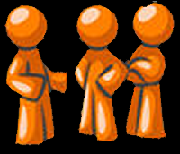
Introductions…
Please share the following information
Your name
Your educational role
What you like to take away

Slide 3
The Challenge
How can educators using Moodle openly share courses, resources & expertise?

Slide 4
Questions are welcome at anytime…

Slide 5
What do we want to do?
Encourage open two way sharing – a give and take of courses and resources
Use a Moodle Hub to facilitate course sharing
Collaborate to create effective student centered on-line courses working with other educators
Create a community of practice

Slide 6
What is Open Sharing?
Define sharing before entering collaboration
Open sharing – little bits or chunks – share what you can
Talk with your jurisdiction, what does sharing mean to them?
Voluntary participation for sharing

Slide 7
What does sharing courses look like?
Share at any point – it does not have to be perfect… the process of sharing and tweaking is so important, also helps the “takes” to be more willing to customize the course for their context
Courses are not static… we are not publishing
One teacher starts a project/course/resource with the time they have, then pass it on to another teacher to add their time and viewpoint into it… accumulation of efforts

Slide 8
What can we do besides sharing courses?
Focus on best practice for on-line education
How can we all work together to share expertise, strategies and resources
How can we involve parents… communication with families and communities.. (parents have great ideas & are a huge support in education)

Slide 9
How does the community of practice work?
Moderator is the Activator
Shared courses are ‘works in progress’
Everyone contributes to the health of the community
Share the expertise of the team

Slide 10
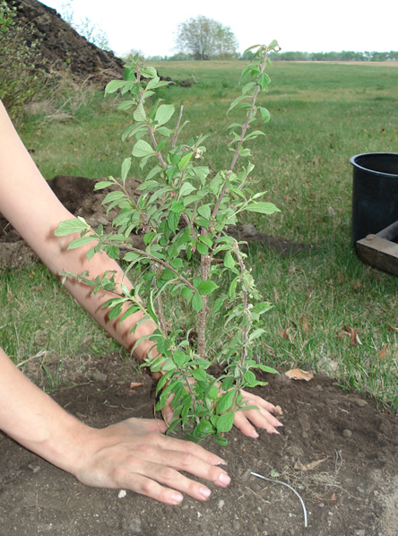
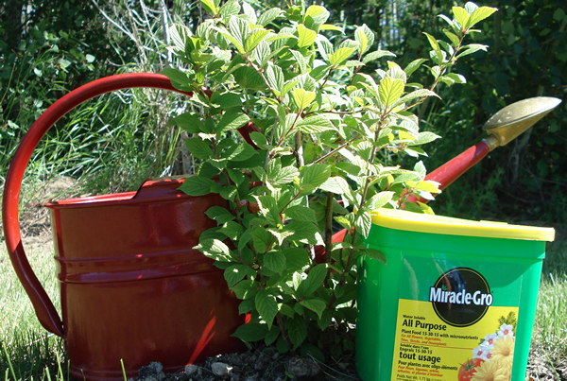
How do we help the community grow?
First, be clear on the focus of the community
Then nurture for growth
Offer what help you can
Ask for what you need
Share successes and challenges
Support fellow educators

Slide 11
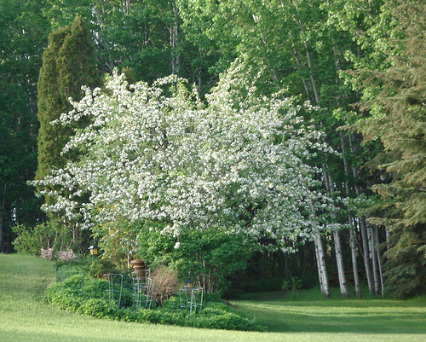
How do we know it is working?
It is working when:
Members ask questions & get answers
Members feel valued and their input is important
Members are comfortable presenting in their areas of expertise
Absences are noticed

Slide 12
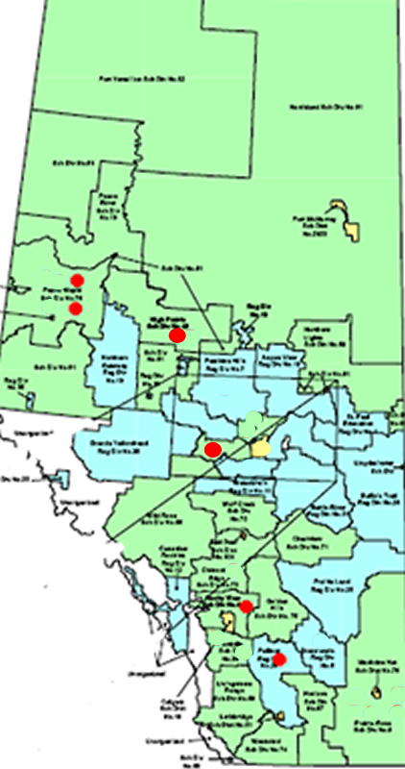
Beginning - 2010-11
This was our beginning in 2010 with 6 educators in 5 different school divisions.
It began as part of Teach AnyWare, an organization of Alberta educators committed to the successful implementation of Online Distributed Learning courses in all learning environments

Slide 13
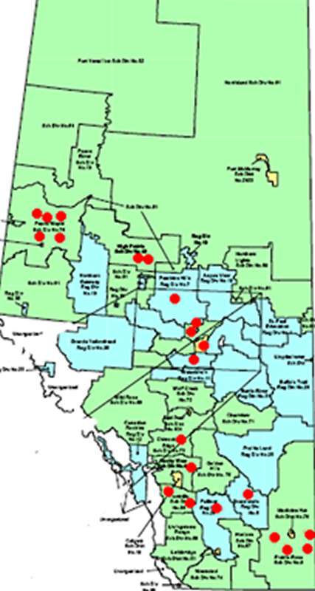
First year – 2011 - 12
By 2011 we had grown to 42 educators in 20 different school divisions.
Topics discussed included
What is open sharing?
How to use Moodle Hub?
Course backup
Moodle course design
Using Moodle 2.x
Quiz Tool & Exam banks
Moodle 1.9 to Moodle 2.1

Slide 14
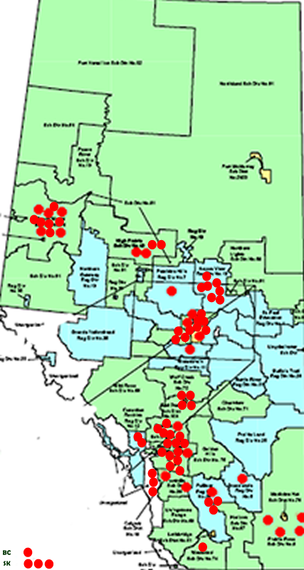
Second Year – 2012 - 13
By 2012 we have grown to 75 educators in 24 different school divisions, colleges, private business and members from BC & SK.
Topics discussed included
How to use Moodle Hub
Repositories – Use & Choices
Moodle course design
Research on Quality On-line Ed
Effective Audio Plug- ins
Alberta Distance Ed Review
Alberta Mentorship – guest speaker
Mahara for portfolios – guest speaker

Slide 15
Informal Learning through a Community of Practice
I think this 2013 article from the Open University speaks well to the nature of the community of practice that we are building
It is entitled: Beyond the Ivory Tower: A Model for Nurturing Informal Learning and Development Communities through Open Educational Practices
Authors:
Tony Coughlan t.coughlan@open.ac.uk
Leigh-Anne Perryman leigh.a.perryman@open.ac.uk
Here is the link:
http://rusc.uoc.edu/ojs/index.php/rusc/article/viewFile/v10n1-coughlan-perryman/v10n1-coughlan-perryman-en

Slide 16
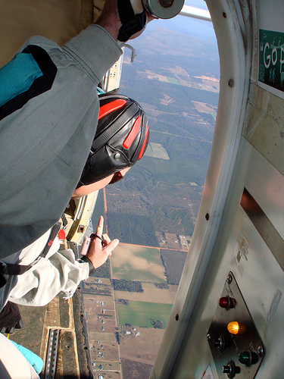
Effective Learning Communities Trust

Slide 17
Effective Learning Communities Respect

Slide 18
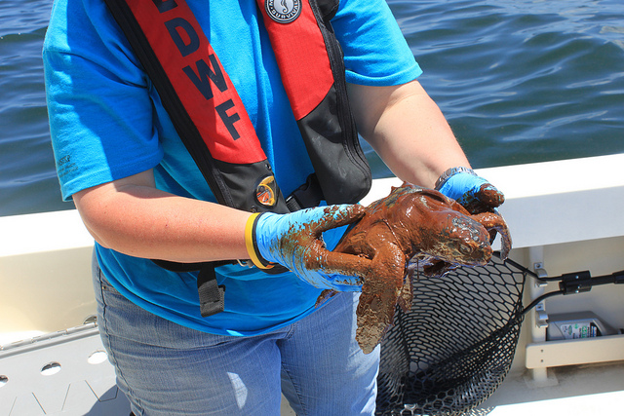
Effective Learning Communities Ownership – do what you can

Slide 19
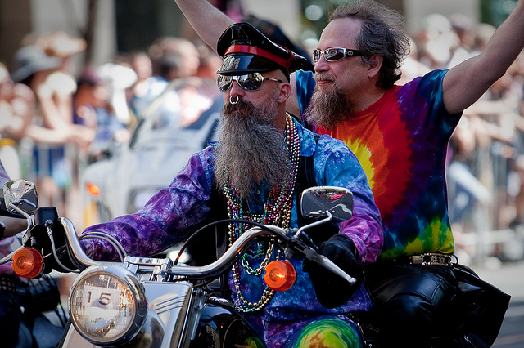
Effective Learning Communities - Open/Accepting

Slide 20
Effective Learning Communities “Check Ego at the door.”

Slide 21
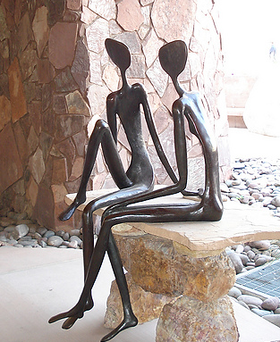
Your Thoughts…
How to make best use of the Moodle Hub?
Other ways to provide sharing opportunities?
How to further develop a strong community of practice?

Slide 22
Credits
Slide #1 Moodle Mini Summit
Slide #2,3,4 Creative Commons & clipart
Slide #14 From the collection of Shelagh Coy
Slide 16,17,18 Adapted from Alberta Ed by Joan Coy
Slide #19 http://www.flickr.com/photos/divemasterking2000/2156349505/
Slide #20 http://www.flickr.com/photos/courosa/3677605158
Slide #21 www.flickr.com/photos/lagohsep/4626873569
Slide #22 http://www.flickr.com/photos/calvinfornia/4740637825
Slide #23 http://www.flickr.com/photos/carlo-arioli/1657433876
Slide # 24 http://www.flickr.com/photos/joancoy

