Slide 1
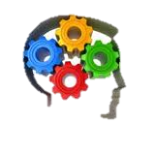
Distributed Education Personalization for Student Success
Joan Coy
Independent Educational Consultant
Nov 20, 2014

Slide 2
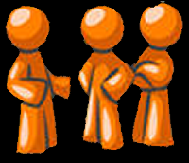
What people are saying…
The Futurist magazine recently predicted that:
‘‘The notion of class time as separate from non-class time will vanish…The next generation of college students will be living wherever they want and taking many (if not all) of their courses online”

Slide 3
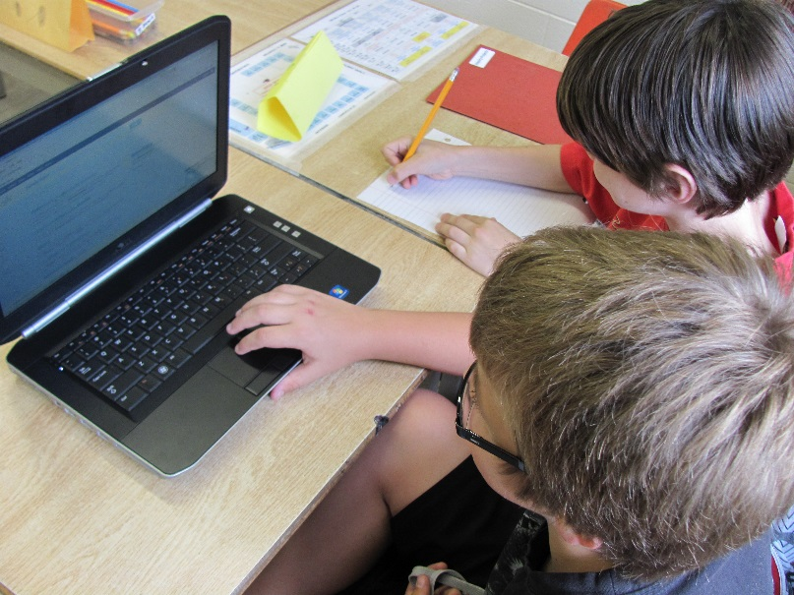
Distributed Education: What is it?
Multi-media instructional delivery that includes combinations of electronic and traditional educational models.

Slide 4
Distributed Education: How does it work?
Distributed learning can be executed in a variety of ways:
It accommodates distance for part (or all) of the instruction
It often uses a Learning Management System (eg Moodle)
It uses web-based instruction to accommodate many ways of learning (read, watch, do)
It focuses on learner-to-learner as well as instructor-to-learner interaction.
It is used by business for staff development and technical training. technical training

Slide 5
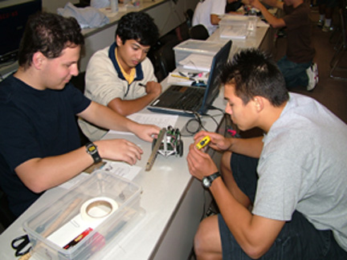
Personalization
Instruction paced to student learning needs and tailored to students learning preferences and interests

Slide 6
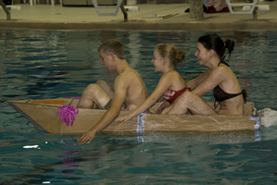
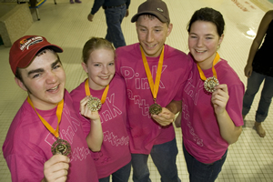
Personalization
Project based and community based learning
Students have power to focus on interests & personal goals
Assessment based on skill development and progress toward goals

Slide 7
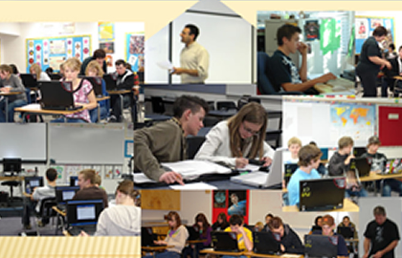
Personalization
Focus is on student success with anytime- anywhere learning
Pace, content and method of instruction vary from student to student
Nearly unlimited instructional sources using the Internet

Slide 8
Blended Learning

Slide 9
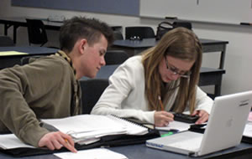
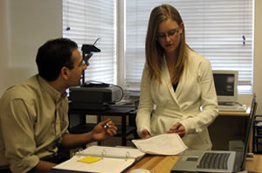
Blended Learning
A formal education program in which a student learns at least in part through online delivery of content and instruction
Some student control over time, place, path or pace.
Face-to-face classroom methods are combined with technology mediated activities

Slide 10
Flipped Classroom

Slide 11
Flipped Classroom
Students learn new content online by watching video lectures, simulations and experiments, usually at home.
Class time for hands-on work. Students learn by doing and asking questions and helping each other building a collaborative approach.
The teacher offers more personalized guidance and interaction with students, working those who need the most help.
Flipping changes teachers from “sage on the stage” to “guide on the side”.

Slide 12
Techology Mediated Learning Project
Vision Statement:
We will blend technology rich on-line learning with the classroom teaching environment to improve the school experience and enhance student achievement.
Goals:
Involve students in authentic learning through technology in order to improve student achievement
Use differentiated instruction to engage students in self directed learning.
Re-engage at risk students in learning through digital content and resources reflected in student completion
Foster a model of cooperation and collaboration in Peace Wapiti
Foster an environment that promotes sustainability

Slide 13
Techology Mediated Learning Project
What students and teachers have to say at the wrap-up of this project
Main site:
joans-place.com
Path: Online Education – Ideas from an Online Educator –Online Learning - Blended Classes
Video:
http://joans-place.com/mod/book/view.php?id=51&chapterid=70

Slide 14
Student Success in On-line Learning
As educators, we have wonderful innovative approaches in teaching, but what about the student point of view?
Flexibility is seen by many students to be a main advantage of online learning
Yet this same feature causes some students to procrastinate or fail to engage in the course.
Self-directed learning involves a specific skill set: organization, motivation, and a sense of confidence.
Can we help student learn to be self directed?

Slide 15
Student Success in On-line Learning
Don’t expect students to know how to be self-directed, they may need to develop this skill set.
Provide students with resources for support in developing their self-direction skills.
Students need access to these resources at the beginning and throughout the course work.
Though there is no perfect strategy that guarantees online success, trying at least one strategy is better than no strategy
We can help student learn to be self directed.

Slide 16
Success in On-line Learning
I developed a little course to help students develop skills for self direction
Learning Style
Learning Needs and Goals
Orient Yourself
What need to know about course
Life Skills
Self Reliance
Time Management
Course Expectations
Communication Skills
Participate
Computer Skills
Trouble shooting ability
Safety on-line
File Management
Learning Environment
Minimize Distractions
Ergonomics
Computer-Activity Balance

Slide 17
Success in On-line Learning
A course you can use and edit in any way you want – backup file is at top of course
Main site:
joans-place.com
Path: Courses– Sample Courses– E-Learning Strategies
Link:
http://joans-place.com/course/view.php?id=7

Slide 18
Reflections on Student Success
A Distributed Learning course is more than a correspondence course.
We need to see students learning at their own rate rather than a ‘lock-step’ approach
Respect that people learn differently – use ‘read, watch do’
Takeaway – a little Moodle course about effective on-line learning strategies
joans-place.com

