Slide 1
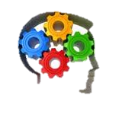
On-line Education in Canada Thoughts on the Future Where have we been and where are we going?
Joan Coy
Principal PAVE
PWSD#76
Oct 28, 2013

Slide 2
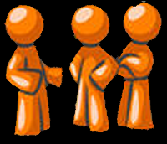
What people are saying…
The Futurist magazine recently predicted that:
‘‘The notion of class time as separate from non-class time will vanish…The next generation of college students will be living wherever they want and taking many (if not all) of their courses online”

Slide 3
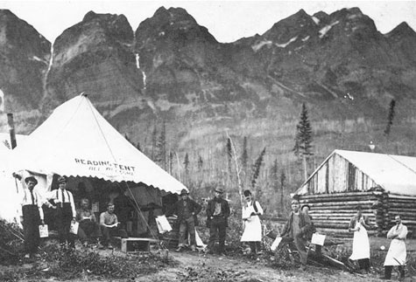
Educating at a distance is not new…
Canada's first adult education institution! Frontier College: 1899
"We must educate the whole family wherever the work is, wherever they earn their living.”

Slide 4
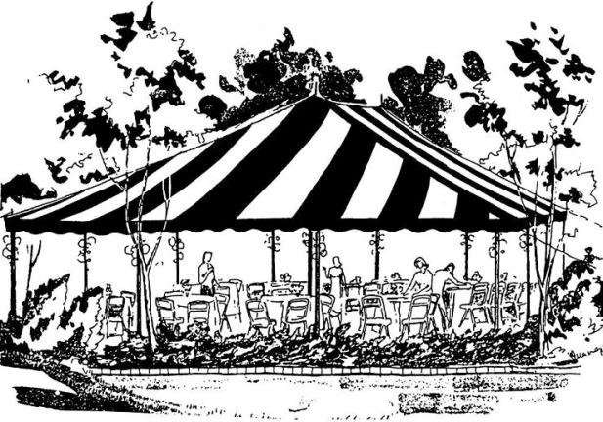
Very early days
Correspondence schools opened (BC 1919, AB 1923, SK 1925) with text packages and assignment books submitted by mail.
Chautauquas 1926 - 1935.
A network of tent circuits across Canada with 5 days of music, lectures, dramas, magic & puppet shows.
Farm Radio Forum 1941-65
National rural listening/discussion group project sponsored by the CAAE, the CFA and CBC.

Slide 5
Internet arrives…
1970s & 80s Satellites used for teleconferencing
1981 OU pilots Cyclops Studio (a multimedia editing system)
1988 OU offers on-line Intro to Information Technology
Learning Management Systems emerge
1989 Lotus Notes (USA)
1997 Blackboard (USA)
1999 Desire2Learn (Canada)
2001 Moodle (Australia)
202 × 146 - spaceref.com

Slide 6
We’re On-line!
At the beginning of the 21st century, the basic asynchronous online learning model gained popularity.
Content delivery controlled by the experts through Learning Management Systems
Discussions conducted via e-mail, forums and web conferencing.
With Web 2.0 and social media, boundaries blurred and the pace of change accelerated.
Students connect by texting and on Facebook and Twitter
New tools promote collaboration in personal learning environments.
Educators work to bring this collaborative model to courses.

Slide 7
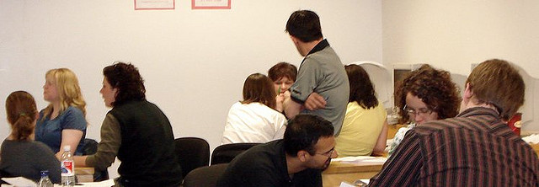
Experimentation
Understanding the need for significant change, educators found the need to collaborate themselves. A culture of open knowledge, open source, free sharing and peer collaboration, emerged in the late 20th century.
Experimentation with on-line learning began and continues today – some examples include:
OER & ODL
Blended/hybrid learning
Flipped classes
MOOCs

Slide 8
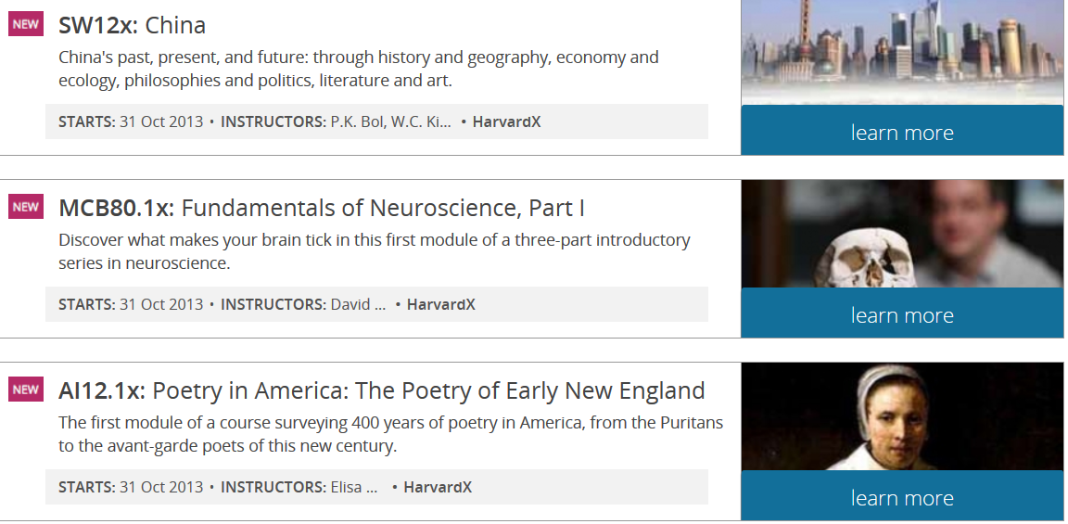
Open Educational Resources (OER)

Slide 9
Open Educational Resources (OER)
By 1998, millions of individuals are engaged in self-directed, informal, and solitary learning experiences with open educational resources (OER)
OpenCourseWare (OCW) appeared in 2001 when the MIT project is credited for having sparked a global Open Educational Resources Movement after announcing that it was going to put MITs entire catalog online.
The
We integrate online learning tools to ultimately enable the students to have more independence, self-direction and choice in their learning, as well as appropriate applications of real world technology,

Slide 10
Blended Learning

Slide 11
Blended Learning
A formal education program in which a student learns at least in part through online delivery of content and instruction emerged in 2000
Some student control over time, place, path or pace.
Face-to-face classroom methods are combined with technology mediated activities
Two major benefits of this approach
opportunity for data collection and
customization of instruction and assessment
Note: also known as "hybrid," "technology-mediated instruction”

Slide 12
Flipped Classroom

Slide 13
Flipped Classroom
First mentioned in 2006, this is a form of blended learning in which students learn new content online by watching video lectures, simulations and experiments, usually at home.
Class time for hands-on work. Students learn by doing and asking questions and helping each other building a collaborative approach.
The teacher offers more personalized guidance and interaction with students, working those who need the most help.
Flipping changes teachers from “sage on the stage” to “guide on the side”.

Slide 14
Massively Open On-line Course (MOOC)

Slide 15
Massively Open On-line Course (MOOC)
First coined in 2008 ,MOOCs are a recent development.
An online course aimed at unlimited participation and open access via the Internet .
course materials such as videos, readings and problem sets
interactive user forums to help build a community for the students and instructors
MOOCs (three goals)
widen access to education
allowing educators to do research into how students learn—like when they like to watch the lectures, where they get stuck, etc. (Learning Analytics)
improving the quality of learning, I think that will come with time.

Slide 16
What do the next few years hold?
“We are reinventing education. This will change the world.” Anant Agarwal, Head of edX (https://www.edx.org/)
We are moving away from the ‘factory model’ that has been the tradition for so many years.
We are looking at student centered learning and a move of the locus of control from teacher to student.
How will this new future in education affect students, teachers, classes and schools?

Slide 17
What will we expect of students?
Competencies from Alberta’s Inspiring Education
Engaged Thinker – Alberta must cultivate students with an inquisitive, engaged mind. Students that are prepared to ask “why?” and think critically about the answers they receive.
Ethical Citizen - Knowing the answer is not enough. Our children and grandchildren must be ethical, compassionate and respectful to truly grow and thrive.
Entrepreneurial Spirit – To shape innovative ideas into real-world solutions, our education system should develop motivated, resourceful and resilient citizens. Alberta would do well to encourage our students to be bold, embrace leadership and actively seek new opportunities.

Slide 18
How may the role of students change?
Desired Student characteristics:
Self-direction
Independence
Inquiry
Critical thinking
Ethical
Motivated
Resourceful
Approaches for Student environment
Choice in learning
Self paced
Discovery learning
Project-based learning
Highly collaborative work
Applications of real world technology

Slide 19
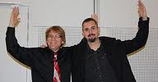
How do we support students?
Students will need help with motivation to become independent learners – a changing emphasis for teacher.
Curt Bonk’s new instructional design model for online learning -- TEC-VARIETY is based motivational principles and is a possibility:
(1) Tone or climate (2) Encouragement or feedback (3) Curiosity (4) Variety (5) Autonomy or choice
(6) Relevance and meaningfulness
(7) Interactivity and collaboration (8) Engagement (9) Tension (10) Yielding products

Slide 20
How may the role of teachers change?
Blended instruction , flipped classes will be commonly used in K to 12.
As classes move partially or entirely online, students work at their own rate –Learning Analytics give teachers detailed info about students.
Outcomes based assessment will become the norm and students will progress based on outcomes achieved
Assessment FOR learning will be used much more intensively to support student self-reliance
Textbooks, even electronic, will disappear as material is integrated into the online course platform, where students can watch a lecture, read an essay and do a homework assignment

Slide 21
How may schools/classes change?
A curriculum focused on outcomes and competencies rather than content
The grades as we know them may disappear as students move through the required K to 12 outcomes at their own rate.
Assessments of progress more performance based (eg e-portfolios) and much less based on one shot, standardized assessments OF learning.
Students in school building less – student centered environment with sustained work being done outside of the building

Slide 22
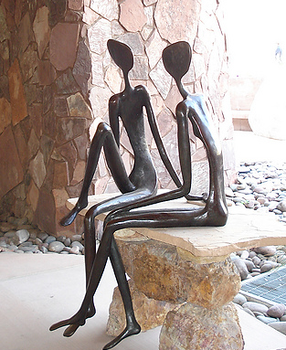
Reflections
We have had distance education in Canada for 115 years with major changes in the last 15.
What do you think the next 10 to 20 years will hold?

